Slide 1

Aquaroom
Ethan Thomas, Jake Stewart, Gabriel Smith-Dalrymple, Gayathri Ramasamy, & Adrienne Co

Slide 2
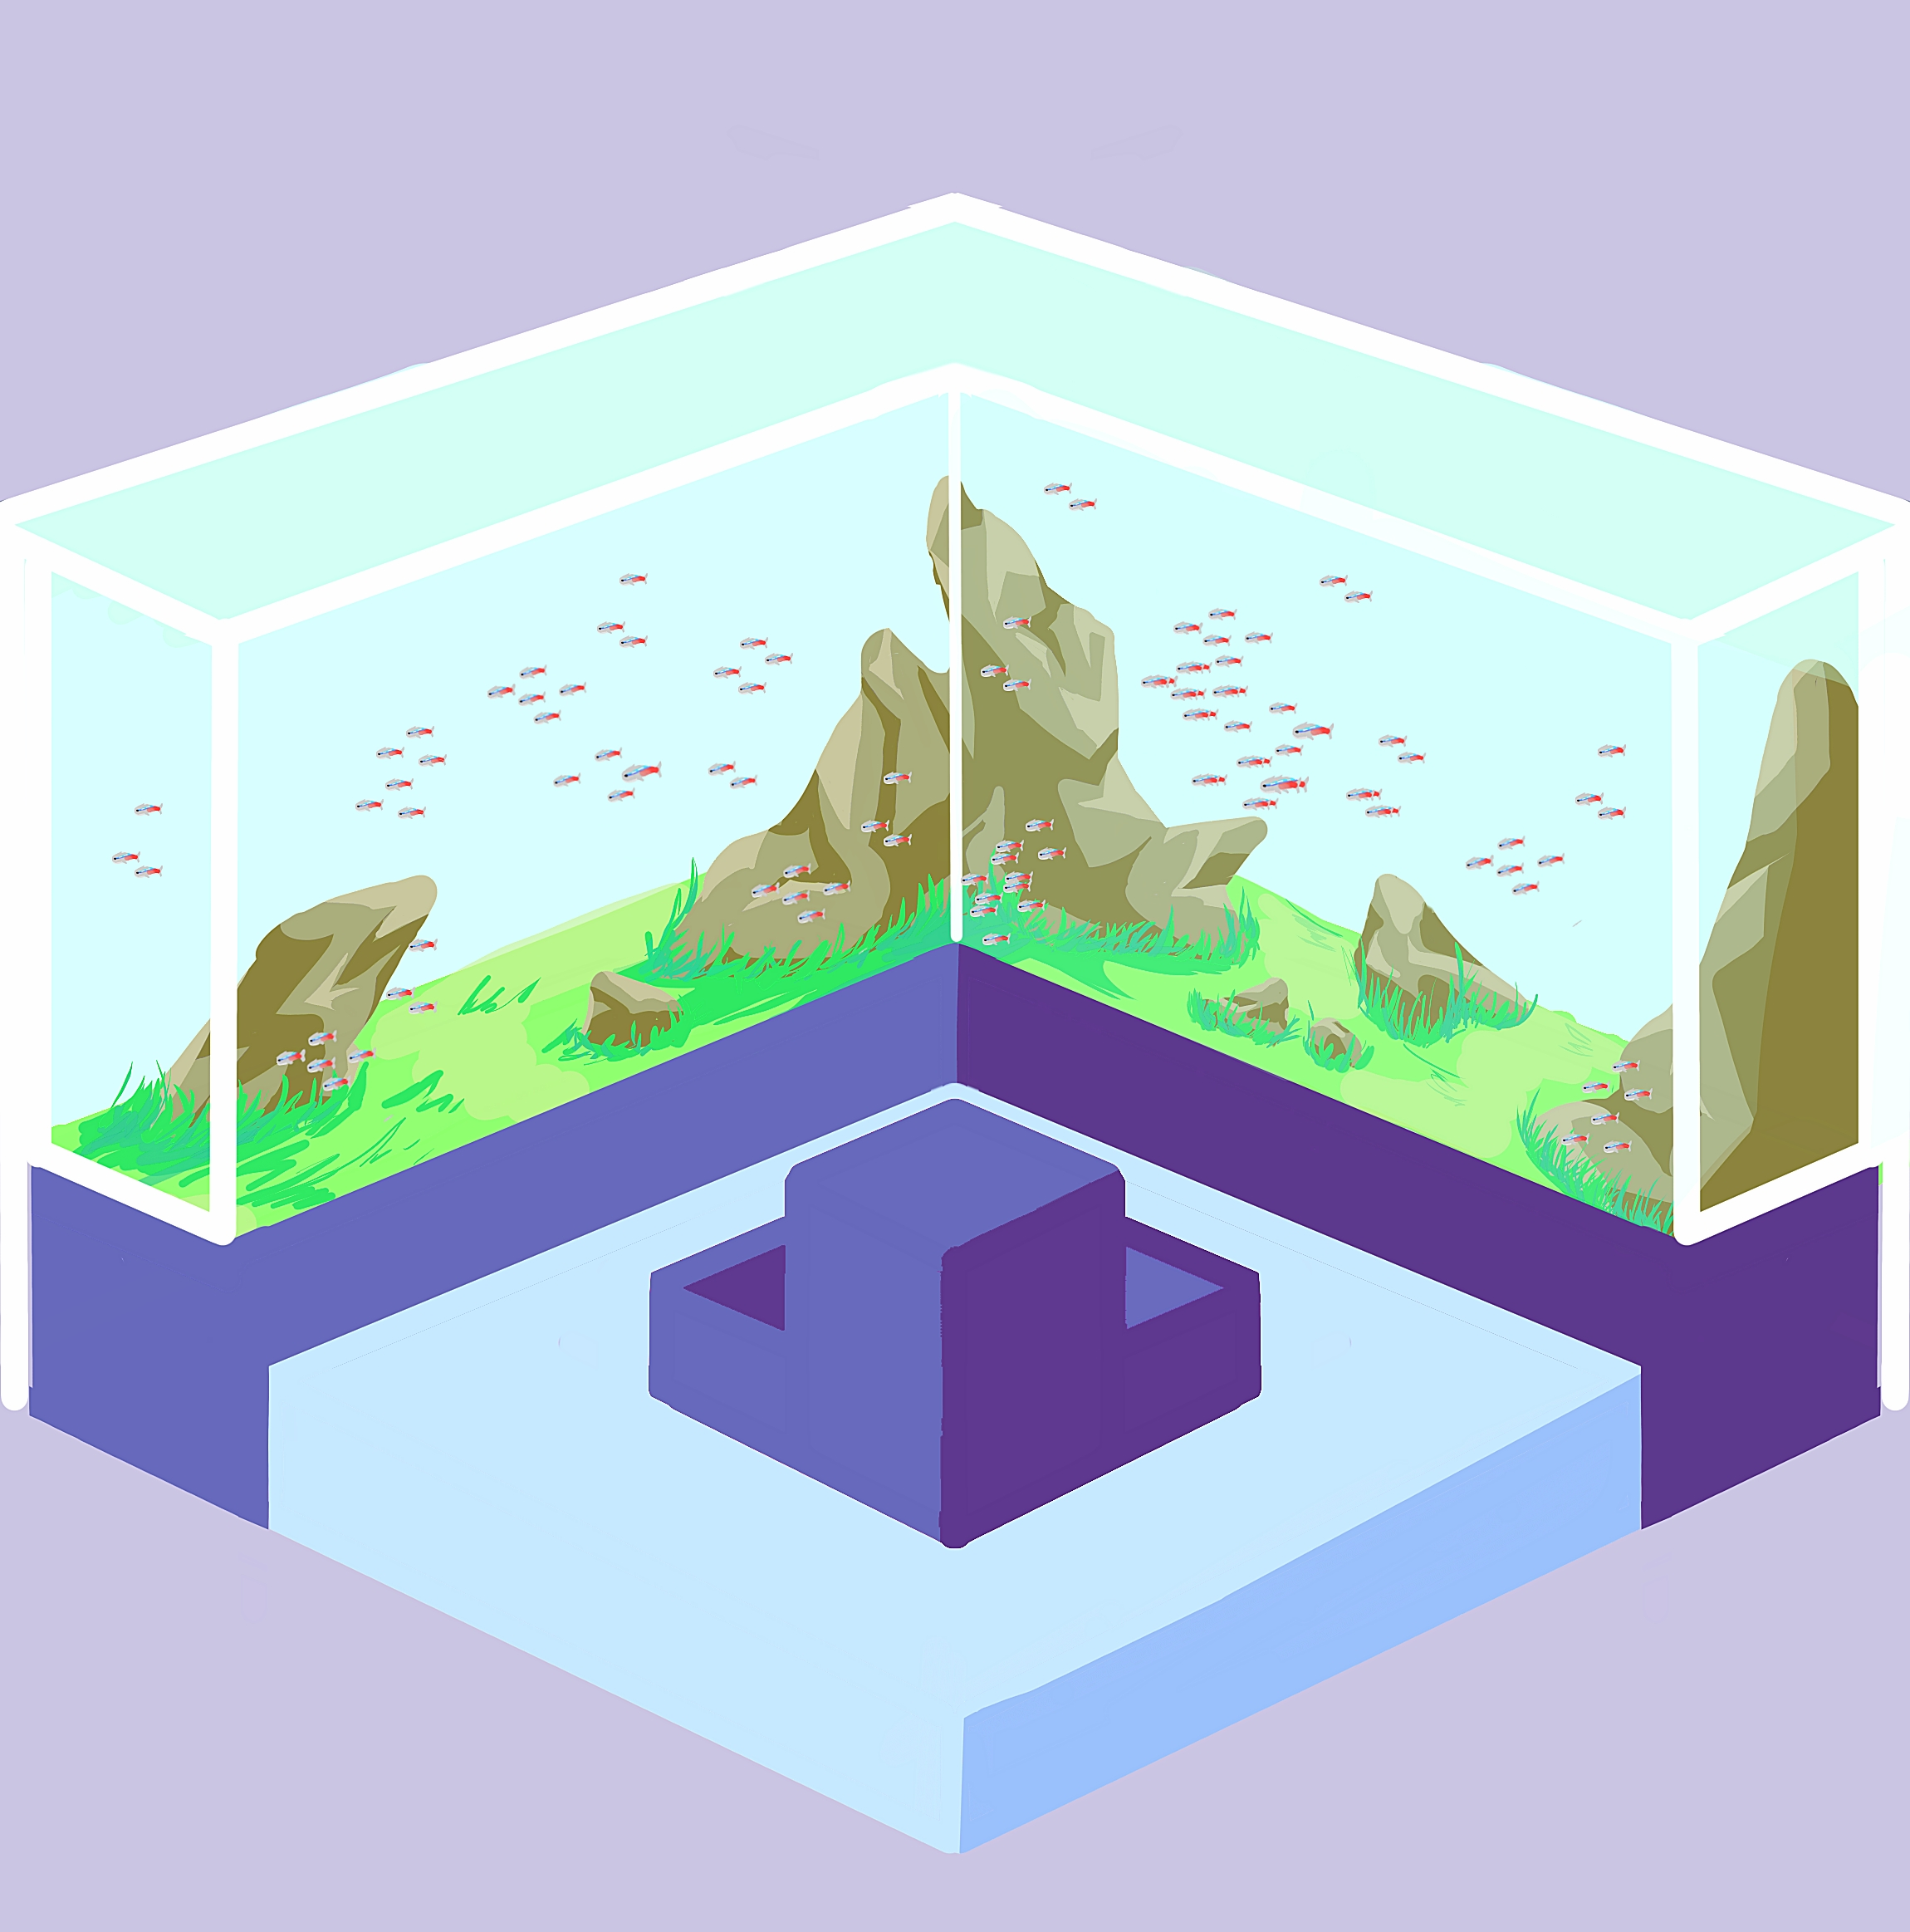
Game Concept
Genres: Design, Idle, Virtual Pet
Audience: Casual gamers
Technology/Platform: Mobile iOS and Android
Free with in-app purchases
Notes:
Something relaxing to play from time to time helps to break down the daily grind
Aquaroom gives you aquariums that you can nourish and watch grow and progress idly in the background as a calming, stress-free game that you can play at your leisure
With progression taking place continuously in the background, players can design their own aquariums and exhibits to increase background progression.
This game is catered to casual gamers who are expected to play for mobile games for about 24 minutes daily, and which, according to the Gamer Segmentation 2018 report, makes up 19% of over 211 million Americans who play video games.
To reach the largest pool of this audience, we plan to develop Aquaroom for mobile iOS and Android
Additionally, to keep up with our competitors whose applications are overwhelmingly free to play with in app purchases, we will be following suit

Slide 3
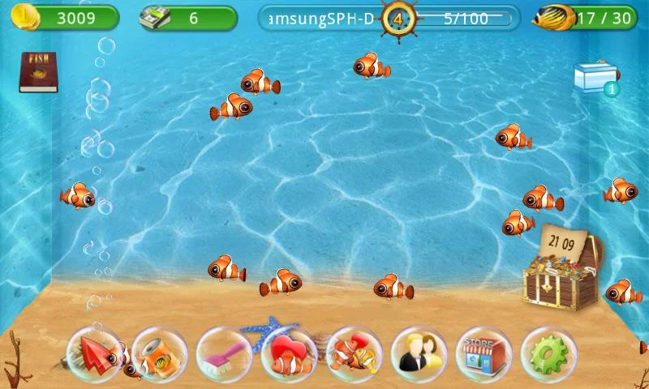
Fish Live
Buy, breed, and care for fish
Decorate your tank and visit other tanks
Notes:
Looking at other mobile aquarium games,
One of the most notable ones is called Fish Live which has over 10,000,000 installs, 593,000 reviews and a 4.3 star rating on the Google Play Store
There are also several similar apps with many reviews and high ratings
Fish Live, and apps of the like, all have a major focus on the types of fish and taking care of them, and you can also decorate your tank with tacky decorations and visit other tanks

Slide 4
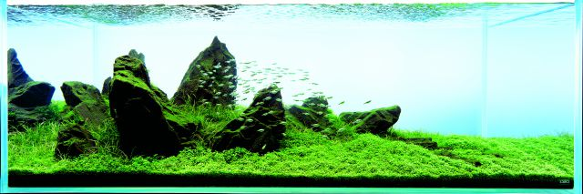
Gaps in Content
An aquarium is more than just its fish
Aquascaping
Outside the tank
Notes:
So, what else can we do this?
There are a few gaps in these existing fish idle games that can be filled in. By appealing to these, we can draw in an audience beyond virtual fish hobbyists
An aquarium is much more than just its fish
There’s the aquascaping: when you place your plants, rocks, and other decor to create an appeasing environment
But there’s also the outside environment

Slide 5

Story
Design and create an aquarium gallery
Aquascape your tanks and add fish
Design the exhibit around your tank
Visit your friends and see their aquarium
Notes:
The general story is that you’re designing and creating aquarium exhibits for a gallery
People will constantly be walking through your gallery, so you’ll earn money as you evolve your tanks and layout to make even more exhibits

Slide 6
Aesthetics:
Outside the Tank
Art Style
Simple 3D models
Cel shaded
Pastel colour palette
Modular Exhibits
Isometric
Individually viewed
Notes:
The art style is meant to be simplistic: so simple shapes and 3d models are cel shaded and have a calming pastel colour palette
This is an example of what one exhibit can look like, and the idea is that you’ll be designing multiple different exhibits
Each exhibit exists in isometric modules so you can focus on one exhibit at a time when designing;
additionally, doing this would help keep the amount of elements on screen lower compared to if the entire gallery were to be viewable at all once

Slide 7
Notes:
Here’s an example of another exhibit on the left with a different colour palette, exhibit and aquarium set up, and fish.
Users can cycle through their different exhibits, and each may have a different theme and look to them

Slide 8
Mechanics
Goal: Create aquarium aquascapes and exhibits to unlock more decorations and gallery space
Choose fish for your aquarium and place items in the exhibit (gridded placement)
In-Game Currency: Buy new fish, decorations, and more space
Earn by:
Taking care of your fish daily (feed and clean)
Using higher-ranked fish and decorations
Earns more when game is on idle
Notes:
The goal is to create aquascaped aquariums and exhibits for your gallery to unlock more decorations and gallery space
You can choose which fish you want for your aquarium and decorate the aquarium and exhibit through an isometric grid placement system which helps prevent over cluttering the screen to an extent and for easier placement of items
In-game currency allows you to buy new fish, decorations, and more space
Doing so allows you to earn more in-game money passively
Additionally, you can earn by taking care of your fish daily by feeding and cleaning

Slide 9
Mechanics
Viewing other Players’ Exhibits
Helps earn them and yourself in-game currency
Seasonal events
Achievements
Daily goals and rewards
Long-term milestones
Clear progression through:
Adding new fish
Making more tanks
Decorating your gallery
In-App Purchases
In-game currency and items
Extra exhibit space
Notes:
You can also view other players’ exhibits that they choose to share
Viewing them helps them and yourself earn in-game money
And there will also be seasonal events with specific themes in which you can view and choose to vote for an exhibit; votes can then that translate to special fish or decorations
Aside from a social incentive to play, there will be a range of achievements that reward users with items and currency as they continue playing
For example, they may earn rewards for performing daily tasks like fish care, and also by completing achievements as they naturally build up their gallery
Users also have the option to make in-app purchases to earn more currency for out-of-reach decorations, fish, and exhibit space

Slide 10
Estimates
Cost to develop: $150k
Number of art assets
Online sharing and voting features
Development time: 6-8 months
2-3 months of pre-production focusing on a vertical slice of the game
3-4 months of development time developing the rest of the game
1 month of post-production marketing, going to cons and events
Potential Revenue: Mobile Gaming is a “hot market”
Mobile gaming takes up 47% of the global gaming market
In 2018, 73% of app revenue came from mobile gaming
Avg $ spent by a US consumer on mobile gaming: 60.25(2014) → 70.44(2015) → 77.60(2016)
66% of mobile gamers have purchasing influence on those around them
Notes:
We estimate a 150k development cost given the number of art assets that need to be created and the online sharing and voting features
We’re aiming for a development time of between 6 and 8 months
There is a lot of potential revenue to be gained
Citation for potential revenue:
https://influencermarketinghub.com/mobile-gaming-statistics/

Slide 11
Questions?

